Slide 1
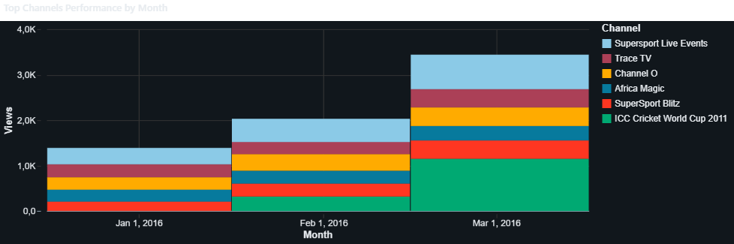

BRIGHT TV ANALYSIS
Created By : HITEKANI MASINGI

Slide 2
Contents
Introduction
Analysis plan
Viewership Analysis
Recommendations and KPI
Q&A

Slide 3
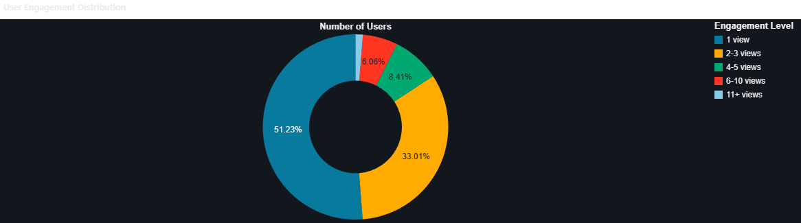
introduction
The purpose of this analysis is to help BrightTV better understand its customers by analysing user demographics, viewing behaviour, and subscription trends. The goal is to identify patterns that can support business growth and improve customer engagement. Ultimately, the CEO wants to use these insights to increase subscriptions, retain more customers, and make informed decisions that strengthen BrightTV's position in the streaming market

Slide 4
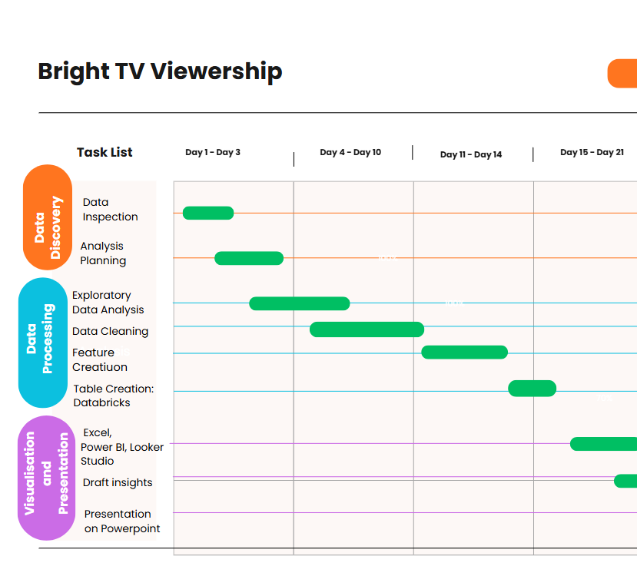
Analysis plan
Project Plan
analysis process planning and process flow diagram using Canva project timeline Gantt chart

Slide 5

Analysis Plan
2. Data processing
Databricks
3. Data Visualization
Lovable AI for dashboards creation
Databricks dashboards
Data studio
Microsoft Excel
4. Presentation
Microsoft PowerPoint

Slide 6
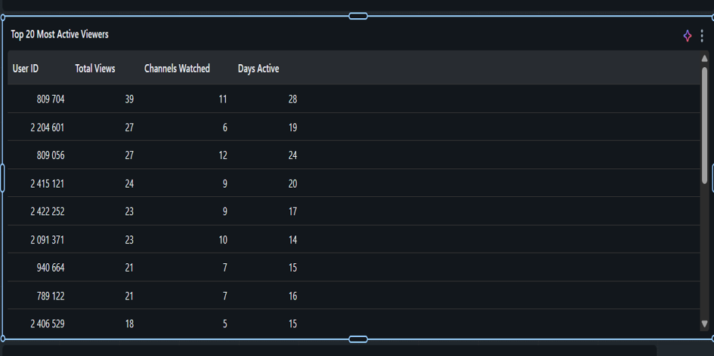
Viewership analysis
Chanell Insights
There are 21 TV channels.
The total number of TV views is 10.0K over the 4 months period.
The most viewed channel is SuperSport Live Event and ICC Cricket World cup 2011 then channel O music.

Slide 7
Recommendations & Key insights
Business Recommendations
Schedule premium content during peak viewing hours. Invest more in high-performing TV channels. Improve underperforming channels through refreshed content. Personalize recommendations based on viewer demographics. Increase customer engagement through email and social media campaigns.
Key Insights
Viewership changes throughout the year,indicating seasonal viewing patterns. A small number of TV channels generate the highest engagement. Peak viewing occurs during specific hours of the day. Certain regions contribute a larger share of viewers. Audience demographics provide opportunities for targeted content and marketing campaigns.

Slide 8
Conclusion
"This analysis demonstrates how data can be used to better understand viewer behaviour and improve business performance. By leveraging these insights, BrightTV can optimize content strategy, strengthen customer engagement, and support sustainable growth."

Slide 9
By Hitekani Masingi
Q & A
Thank you

